Slide 1


Slide 2
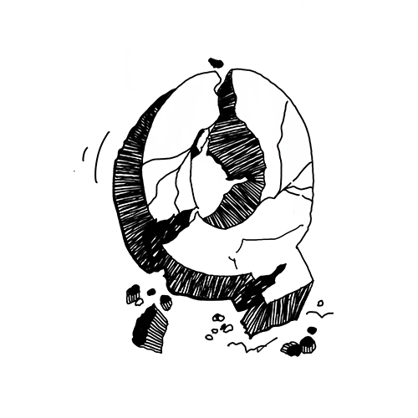
Group 11
QUAKE
ANALYSIS OF NEAR FAULT NON-PULSE GROUND MOTIONS USING ARTIFICIAL NEURAL NETWORK MODELS

Slide 3





Meet The Team
ADVAITH
SRUTILEKA
SRIJA REDDY
Team Leader
Design Lead
Front-End Developer
DIVYA
PRANAV
Front-End Developer
Back-End Developer

Slide 4
Project Outline
This project aims to train a model to predict whether earthquake is possible or not when inputted with parameters like longitude, latitude, depth, azimuthal gap and root mean square.
This project aims to showcase the efficacy of deep learning in earthquake recognition and prediction by leveraging the increasing number of seismic monitoring stations and reduces causality and recovery funds for the destruction caused by earthquakes by being warned about the severity.
PROJECT OUTLINE
This project aims to train a model to predict whether earthquake is possible or not when inputted with parameters like longitude, latitude, azimuthal gap and root mean square.
This project aims to showcase the efficacy of deep learning in earthquake recognition and prediction by leveraging the increasing number of seismic monitoring stations and reduces causality and recovery funds for the destruction caused by earthquakes by being warned about the severity.

Slide 5
I
INDEX
What are we trying to build?
Abstract
Business Use Case
Important Use Case
Concepts Used
Our Data
Algorithm Used
Optimal Case
Visualization
Final Recommendation
Challenges Faced
Our Learning
Future Enhancements
Demo

Slide 6
What we are trying to build
We are trying to build an active model which utilizes deep learning techniques in earthquake seismology by employing neural networks to analyze seismic data.
The neural networks are trained on labeled data to enhance earthquake recognition and prediction, resulting in faster and more precise identification.
The project has significant implications for mitigating earthquake hazards, providing timely warnings, and improving decision-making in earthquake preparedness and response.

Slide 7
Abstract
Earthquakes in nutshell acts as nexus between tectonic rocks and various factors causing Quake. Developing accurate earthquake prediction models is crucial for effective disaster preparedness and risk management. The proposed model leverages historical earthquake data, seismic activity patterns and various geophysical features to predict the occurrence, magnitude, and location of earthquakes. This model is not only limited to the usual factors rather it emphasises on wide range of factors for more fidelity and accuracy. The model includes data collection, preprocessing, model training, and evaluation but widespread to more factors.

Slide 8
Business Use Case
Insurance companies - Insurance companies often face significant financial losses due to earthquake-related claims. By implementing an earthquake prediction model, insurance companies could better assess the risk associated with insuring properties in earthquake-prone areas.
Infrastructure and planning - Government agencies and civil engineering firms can leverage such models to make informed decisions regarding the design, construction and maintenance in earthquake prone areas.
Supply chain management - Supply chain disruptions can have significant impacts on businesses.

Slide 9
Important Use Case
The predominant use case is the early warning system.
Warning Generation: Based on the analysis, if the system detects an earthquake, it generates an alert or warning message. The warning can be transmitted through various channels, including mobile phone notifications, television and radio broadcasts, and smartphone applications.

Slide 10
Why Quake?
Detecting Ground Motion, Seismometer Deployment etc. are few ways seismologists predict the earthquake.
But, in Quake we Forecast the earthquake (just like how we forecast weather) by previous earthquakes and the under-looked attributes of an earthquake.
In the methods mentioned above, the seismologists analyze the rocks, the land around ad many more factors including tectonic gap.
But our model uses the old data of previous earthquakes.
Earthquakes is directly proportional to it's frequency.
Hence by training the model, we can give the probable answer.

Slide 11
Concepts Used
The main concept used here is Seismic wave Analysis incorporated with Deep Learning algorithms.
This model utilizes deep learning techniques in earthquake seismology by employing neural networks to analyze seismic data.
The neural networks are trained on labeled data to enhance earthquake recognition and prediction, resulting in faster and more precise identification.

Slide 12
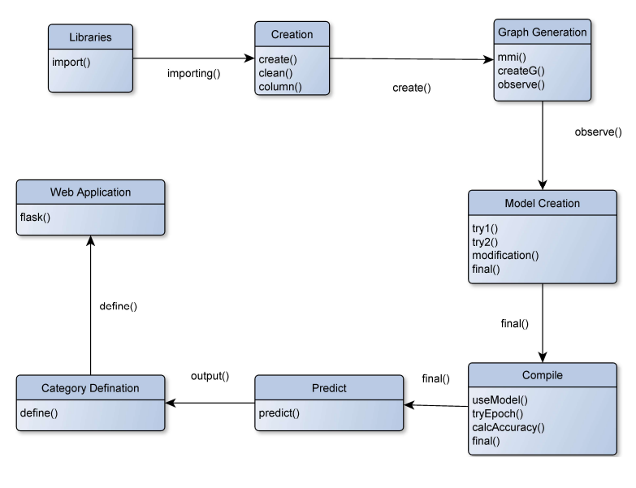
System Model

Slide 13
Our Data
The dataset contains 75000 rows of data. Each row is described with Date, Time, Longitude, Latitude, RMS, Depth, Magnitude and it's type (MW) and Azimuthal Gap, etc
The data was obtained from a server NCEDC - Northern California Earthquake Data Center & some part from Kaggle to maintain accuracy

Slide 14
How we Processed Data
Pre-processed using Pandas(read data), created a new column for MMI values, NumPy for data cleaning(taking off null values).
Data is collected from the NCEDC network by configuring parameters such as time, radius, and magnitude threshold. The code connects to the NCEDC client, retrieves station information, and obtains seismic events for each station.
Events are filtered based on magnitude and radius, and positive events are stored in a list.

Slide 15
Comparison of Models
Random Forest - Disadvantageous as it requires higher computational power as it requires numerous trees to combine their outputs. This model outputted an accuracy of 73%. Although this model reduces variance and improves accuracy, it is not employed as it is a very high .
Logistic Regression - The major disadvantage of this model was that it works well when the parameters are independent of each other, due to this disadvantage the model had an accuracy of 81%.
SVM- Linear SVM world better if the number of parameters are less. The dataset had many features and hence was difficult to train and resulted in an accuracy of 83%.

Slide 16
Algorithm Used
This paper presents an overview of an earthquake prediction model utilizing Deep Learning algorithms. (ANN)
The paper excludes date and time data as earthquakes are not predictable and do not depend on these two features.Then, a Sequential model is used to train the model.
The loss function is computed using a Binary cross entropy model.
The activation function uses 'ReLu' and 'Sigmoid' function. The model uses 2 hidden layers and 1 sigmoid output layer.
Ngrok is used for server hosting.

Slide 17
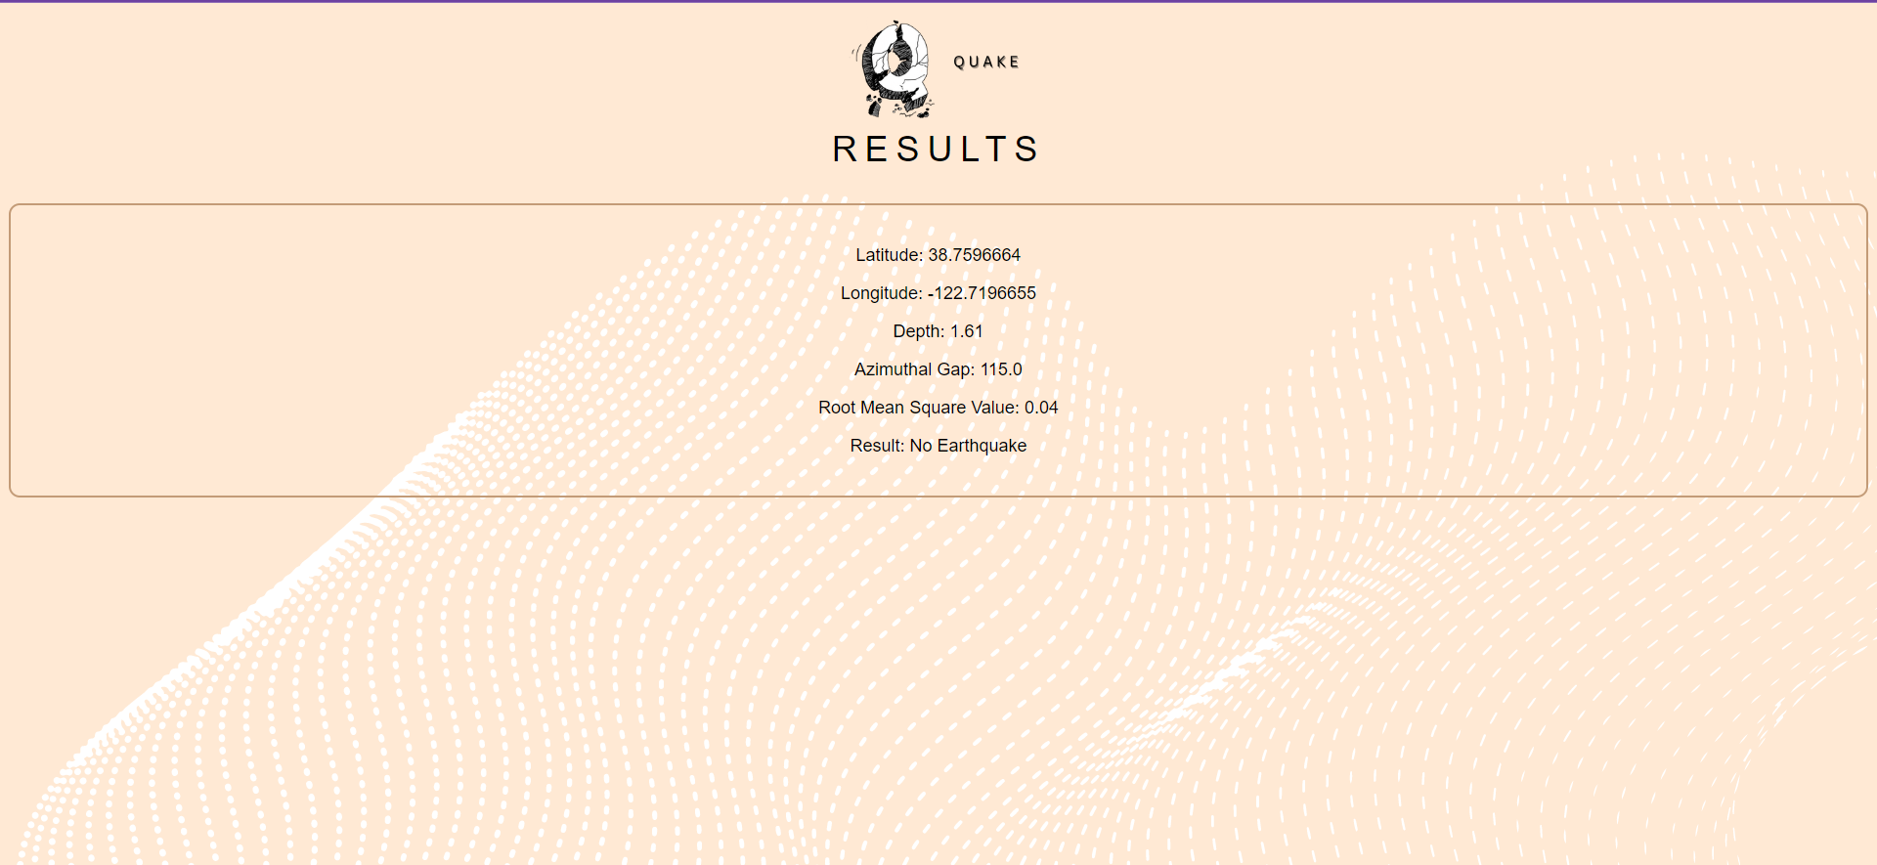
Optimal Case
How we Processed Data
Data is collected from the NCEDC network by configuring parameters such as time, radius, and magnitude threshold. The code connects to the NCEDC client, retrieves station information, and obtains seismic events for each station.
Events are filtered based on magnitude and radius, and positive events are stored in a list.
LATITUTUDE: 38.75
LONGITUDE: -122.72
DEPTH: 1.61
AZIMUTHAL GAP: 0.05
RMS: 0.04
PREDICTED OUTPUT: NO EARTHQUAKE
ACTUAL OUTPUT: NO EARTHQUAKE

Slide 18
Our Output
Once the attributes are provided, the model gives either:
Earthquake
No Earthquake
It will not give the probability of when the earthquake will occur, because there is no correlation between Time/Date and Occurrence of Earthquake.
So, our model just gives a forecast whether earthquake is possible in that area or not, in the near future.

Slide 19
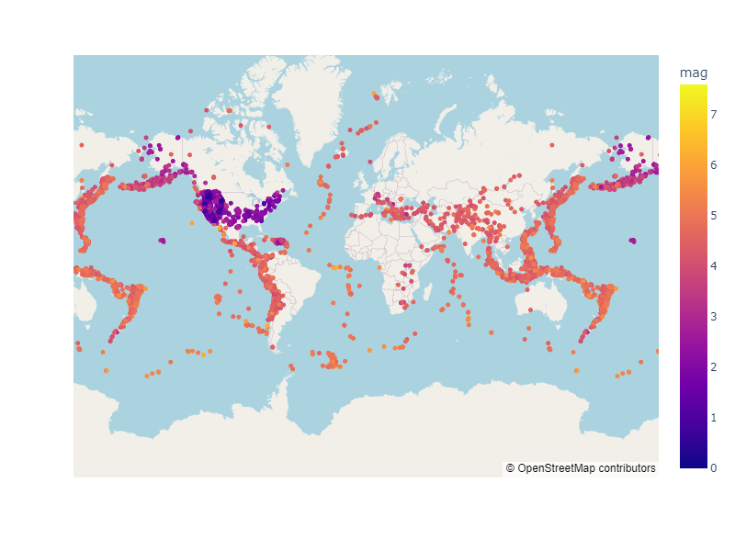
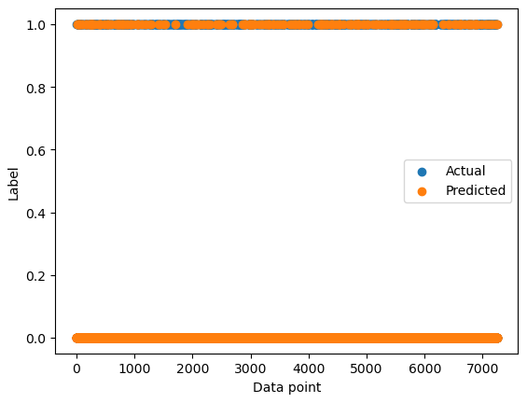
Visualization
Earthquakes around the world
scaled based on their magnitude
Actual vs Predicted graph

Slide 20
Challenges Faced
Data Quality: Seismic data can be affected by various sources of noise and interference, including null values, negative magnitude values, etc.
Detection Threshold: Detecting smaller-magnitude earthquakes is more challenging than detecting larger ones. Smaller events often produce weaker signals that are harder to distinguish from background noise.
Near-Field vs. Far-Field Events: Detecting earthquakes that occur in close proximity to the monitoring stations (near-field events) is generally easier than detecting distant earthquakes (far-field events)

Slide 21
Our Learning
Learnt how to implement and work around earthquake data.
More attributes can enhance the quality of results.
Remember to handle errors gracefully, and consider implementing alert systems or notifications for significant earthquakes.

Slide 22
Future Enhancements
Incorporating the model onto a mobile app can make the application more accessible.
Attempting to get a correlation between date and time of earthquakes.

Slide 23
I
DEMO

Slide 24

I
THANK YOU

